Slide 1
An Efficient and Fine-grained Big Data Access Control Scheme with Privacy-preserving Policy

Slide 2
Abstract
How to control the access of the huge amount of big data becomes a very challenging issue, especially when big data are stored in the cloud. Ciphertext-Policy Attribute based Encryption (CP-ABE) is a promising encryption technique that enables end-users to encrypt their data under the access policies defined over some attributes of data consumers and only allows data consumers whose attributes satisfy the access policies to decrypt the data. In CP-ABE, the access policy is attached to the ciphertext in plaintext form, which may also leak some private information about end-users. Existing methods only partially hide the attribute values in the access policies, while the attribute names are still unprotected. In this paper, we propose an efficient and fine-grained big data access control scheme with privacy-preserving policy. Specifically, we hide the whole attribute (rather than only its values) in the access policies. To assist data decryption, we also design a novel Attribute Bloom Filter to evaluate whether an attribute is in the access policy and locate the exact position in the access policy if it is in the access policy. Security analysis and performance evaluation show that our scheme can preserve the privacy from any LSSS access policy without employing much overhead.

Slide 3
Introduction
In the era of big data, a huge amount of data can be generated quickly from various sources (e.g., smart phones, sensors, machines, social networks, etc.). Towards these big data, conventional computer systems are not competent to store and process these data. Due to the flexible and elastic computing resources, cloud computing is a natural fit for storing and processing big data. With cloud computing, end-users store their data into the cloud, and rely on the cloud server to share their data to other users (data consumers). In order to only share end-users’ data to authorized users, it is necessary to design access control mechanisms according to the requirements of end-users.

Slide 4
Existing System
In order to enable end-users to control the access of their own data stored on untrusted remote servers (e.g., cloud servers), encryption-based access control is an effective method, where data are encrypted by end-users and only authorized users are given decryption keys. This can also prevent the data security during the transmission over wireless networks which are vulnerable to many threats .However, traditional public key encryption methods are not suitable for data encryption because it may produce multiple copies of ciphertext for the same data when there are many data consumers in the system. In order to cope with this issue, some attribute-based access control schemes are proposed by leveraging attribute-based encryption which only produces one copy of ciphertext for each data and does not need to know how many intended data consumers during the data encryption. Moreover, once the cloud data are encrypted, some searchable encryption algorithms are proposed to support search on encrypted cloud data.

Slide 5
Proposed System
1). We propose an efficient and fine-gained big data access control scheme with privacy-preserving policy, where the whole attributes are hidden in the access policy rather than only the values of the attributes.
2) We also design a novel Attribute Bloom Filter to evaluate whether an attribute is in the access policy and locate the exact position in the access policy if it is in the access policy.
3) We further give the security proof and performance evaluation of our proposed scheme, which demonstrate that our scheme can preserve the privacy from any LSSS access policy without employing much overhead.

Slide 6
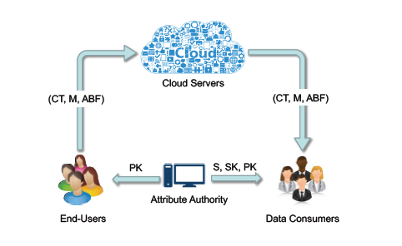
System Architecture

Slide 7
SYSTEM REQUIREMENTS
HARDWARE REQUIREMENTS:
System : Pentium Dual Core.
Hard Disk : 120 GB.
Monitor : 15’’ LED
Input Devices : Keyboard, Mouse
Ram : 1GB.
SOFTWARE REQUIREMENTS:
Operating system : Windows 7.
Coding Language : JAVA/J2EE
Tool : Netbeans 7.2.1
Database : MYSQL

